Slide 1
Decentralizing Authorities into Scalable Strongest-Link Cothorities
Ewa Syta, Iulia Tamas, Dylan Visher, David Wolinsky, Bryan Ford
Yale University
Computer Science Department
National Institute of Standards and Technology – June 10, 2015

Slide 2









“Authorities” are Everywhere
Conceptually simple but security-critical services
Logging, Time-stamping Authorities
Naming Authorites
Certificate Authorities
Randomness Authorities (e.g., Lotteries)
Digital Notaries

Slide 3
Talk Outline
Troubles with Authorities
Cothorities: Large-scale Collective Authorities
A Basic Tool: Scalable Collective ElGamal Log-Signing
The Availability Problem, and Two Solutions
Prototype and Preliminary Results
Future Work: Potential Applications

Slide 4
Authorities Make Statements
Often recorded in tamper-evident public logs
  Each log entry signed by the authority
  Hash chains for consistency verification
But hashes don't solve the forking problem…
Or the freshness problem…
Head
1
record
2
record
3
record
3
record
Head 1
1
record
2
record
3
record
Head 2
“Head”
1
record
2
record
3
record

Slide 5
When authorities go bad...
Compromised authority services can:
Tamper with history: e.g., forge log entries
Pre-date or post-date a timestamp
Equivocate: customize history for each user
Impersonate names and MITM attack
Look into the future: e.g., win the lottery
And usually you're trusting one entity to be good

Slide 6
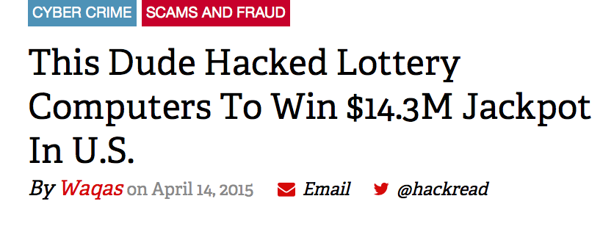
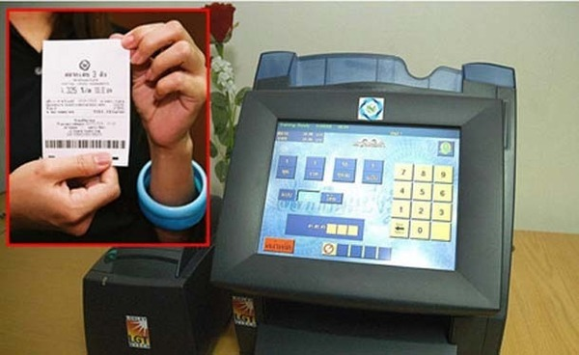
Example: Bad Randomness

Slide 7
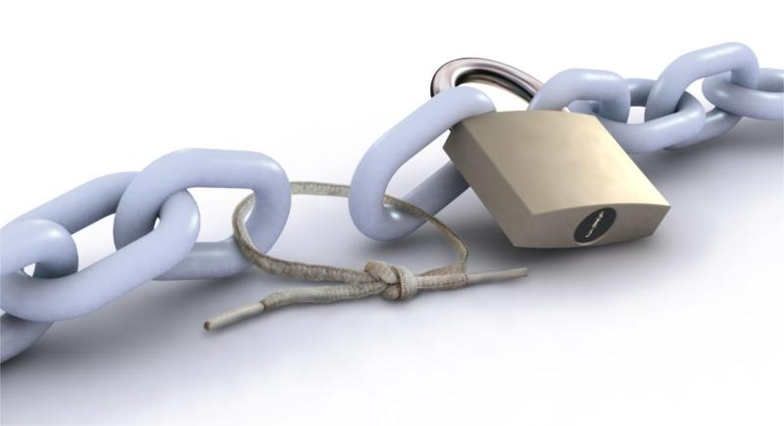
If we trust many authorities…
Attacker gets to choose which authority to attack
→ Weakest-link security overall

Slide 8
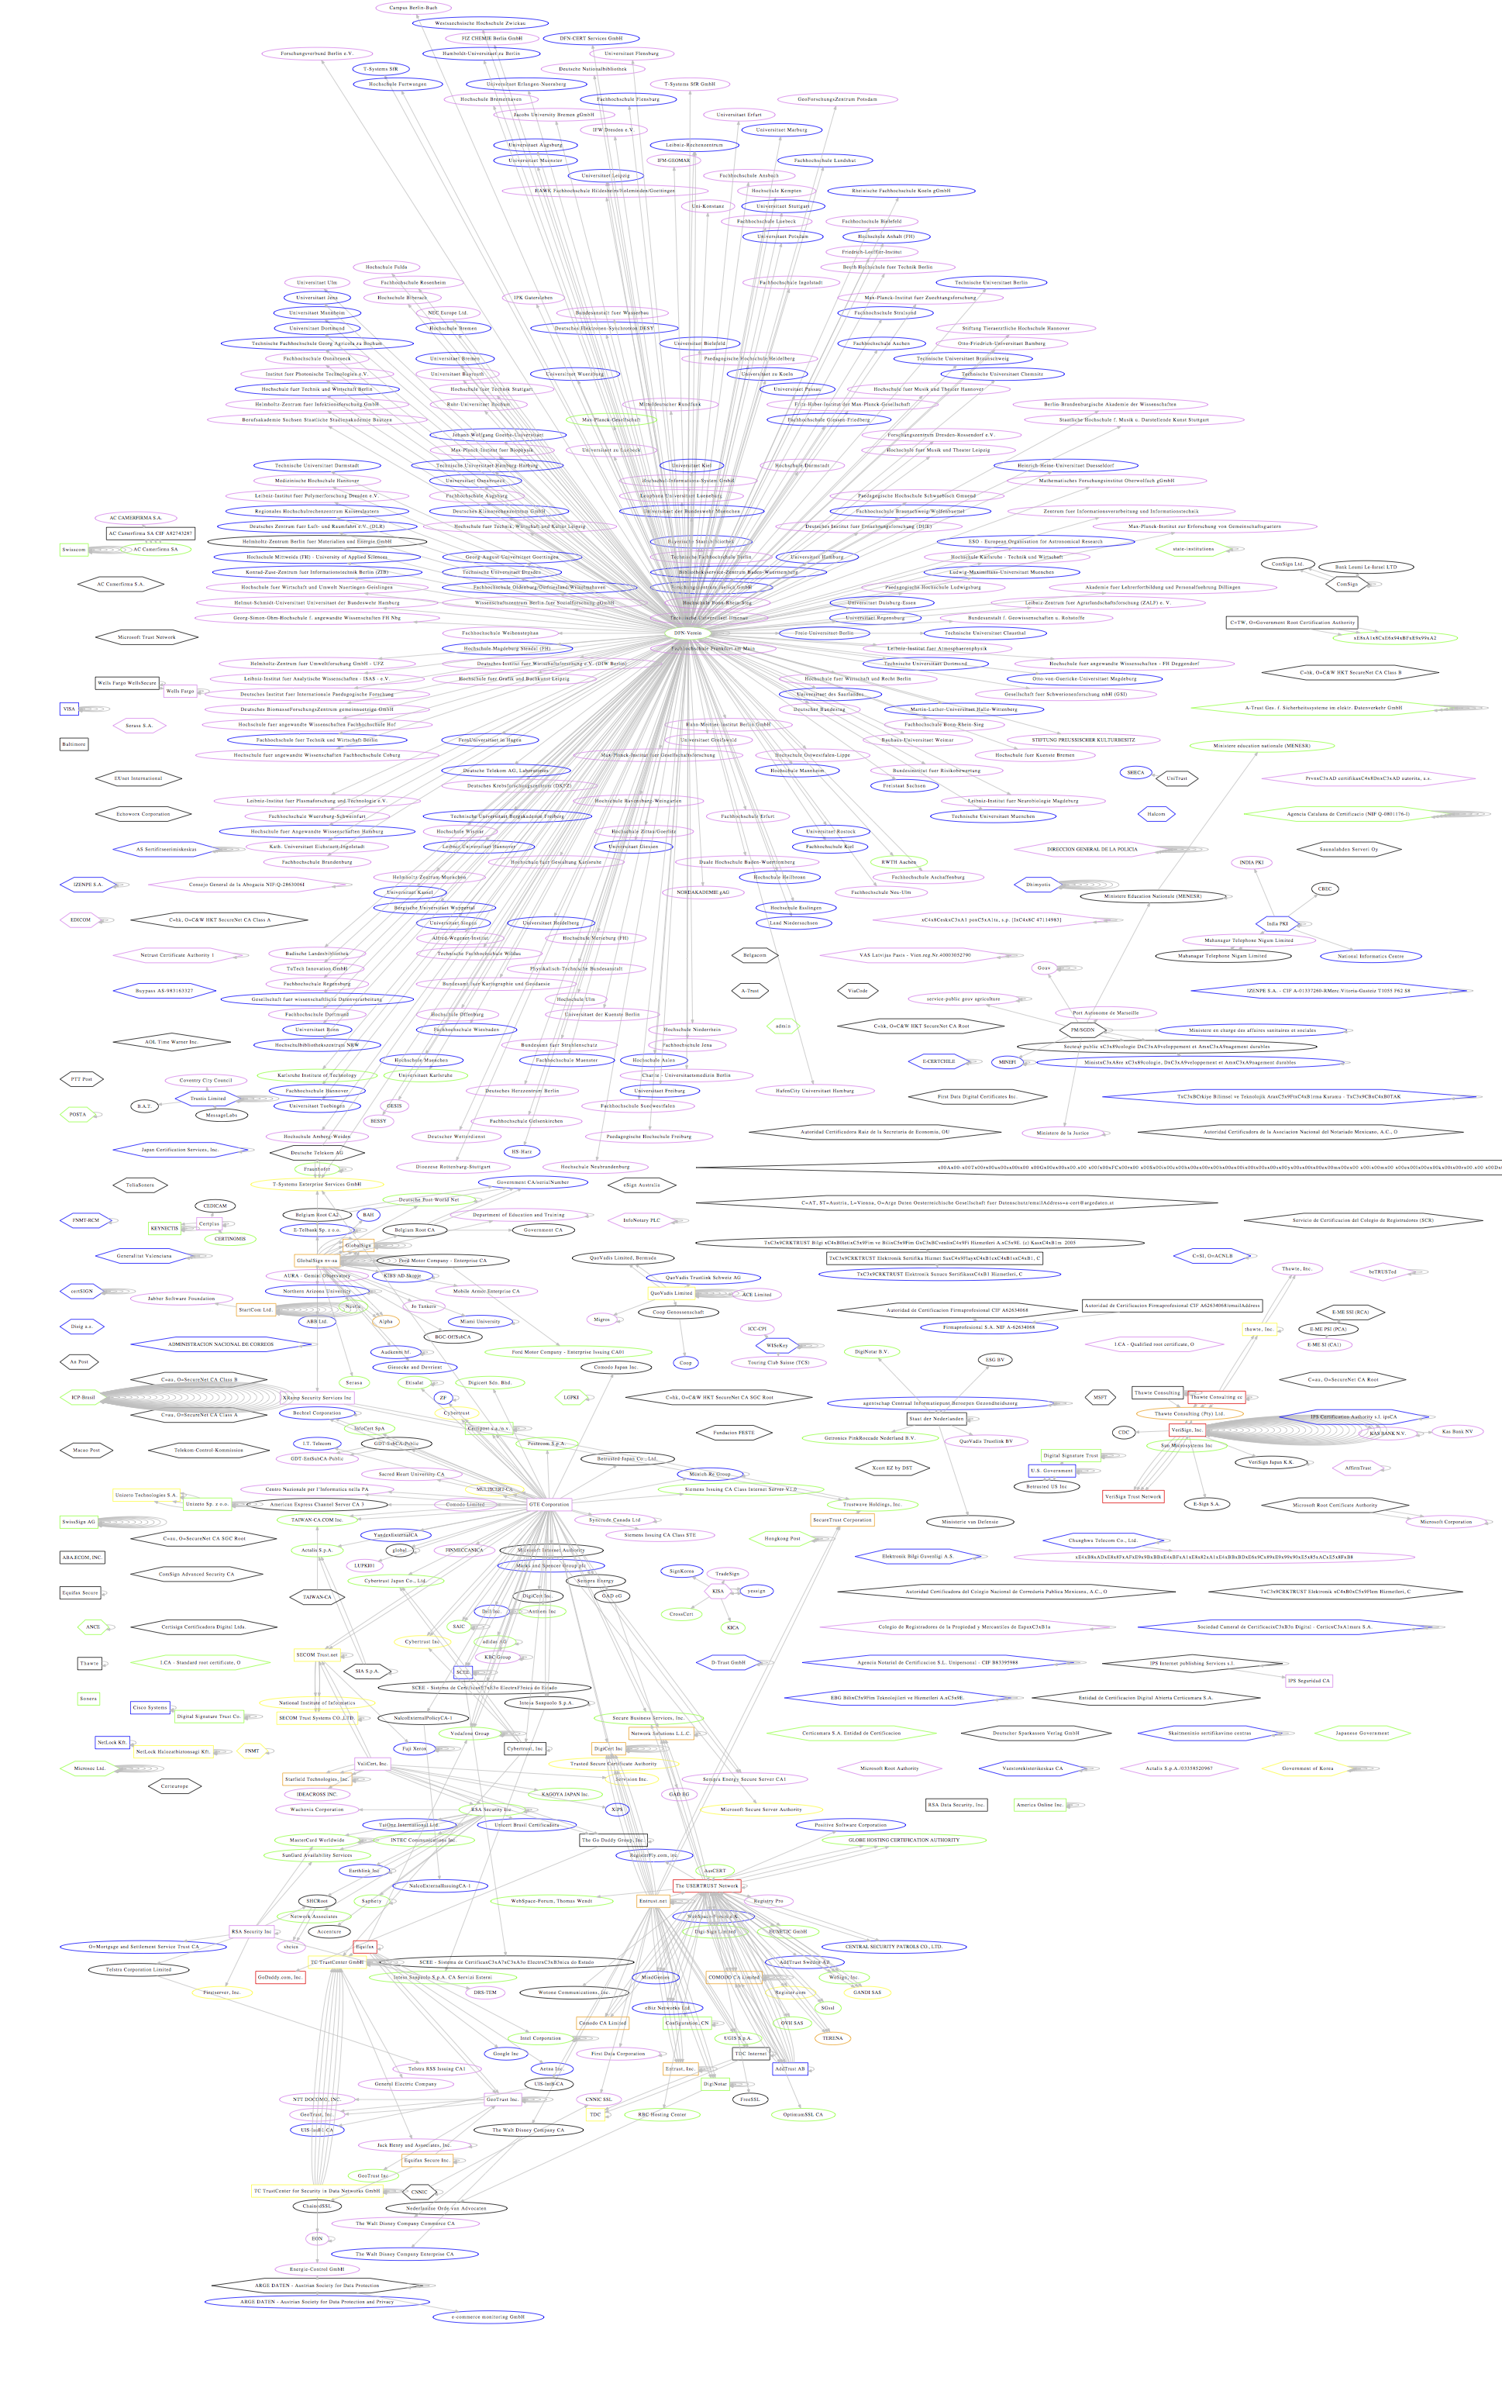

Example: Certificate Authorities
EFF SSL Observatory:
~650 CAs trusted by Mozilla or Microsoft
Any CA can issue certs
for any domain name
Prime key theft target
  MITM attack power
Breaches do happen
  DigiNotar, Comodo, CNNIC/MCS
Notes:
there are hundreds of CAs that can in principle sign a certificate for any domain and this has been misused
German National Research and Education Network, DFN,

Slide 9

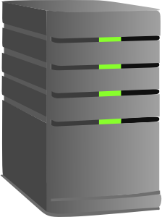






Certificate Authorities
Stolen CA
Private Key
DigiNotar
CAs
Fake Google.com
(MITM Attacker)
Pwned!
Alice (Victim)
Notes:
the client takes time and delays page loads while doing those checks, and
The log/monitor checks might get blocked, e.g., by the evil state-controlled ISP

Slide 10



Certificate Transparency
Stolen CA
Private Key
DigiNotar
CAs
Fake
Google.com
(Attacker)
Real
Public Log Servers
!!!
Alice (Victim)
Monitor Servers
Notes:
the client takes time and delays page loads while doing those checks, and
The log/monitor checks might get blocked, e.g., by the evil state-controlled ISP

Slide 11


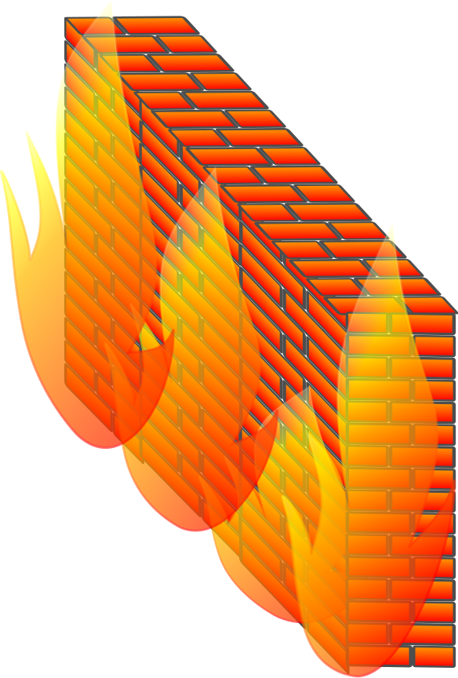

CT's Weakness
DigiNotar
Stolen CA
Private Key
CAs
Dictator
Dave
Fake
Google.com
(Attacker)
Public Log Servers
Pwned!
Alice (Victim)
Monitor Servers
Notes:
the client takes time and delays page loads while doing those checks, and
The log/monitor checks might get blocked, e.g., by the evil state-controlled ISP

Slide 12
Talk Outline
Troubles with Authorities
Cothorities: Large-scale Collective Authorities
A Basic Tool: Scalable Collective ElGamal Log-Signing
The Availability Problem, and Two Solutions
Prototype and Preliminary Results
Future Work: Potential Applications

Slide 13
Splitting Trust in Authorities
We know how to:
Split trust across a few servers, typically <10
  “Anytrust”: only 1-of-k servers need be honest,
  but all k servers need to remain live
  Byzantine Fault Tolerance (BFT): 2/3 of k servers need to be honest, 2/3 need to be live
Split cryptographic keys, operations
  Threshold cryptography, multisignatures
Example: Tor directory authority (8 servers)

Slide 14
Small-Scale Trust-Splitting
Is splitting trust across 5-10 replicas “enough”?
Who owns/controls these replicas?
  Truly independent operators (decentralized),
  or within one organization (merely distributed)?
  All in same country? All in “five-eyes” territory?
What is the real cost of targeted attacks?
  5 Tor directory server private keys might be
  well worth the cost of a 0-day exploit or two
Who chooses the 5-10 replicas?
  Why should “everyone” trust them?

Slide 15
Large-Scale Trust Splitting
Main proposition:
We can and should build authority services to split trust across large-scale collectives
e.g., thousands of replicas/monitors or more
Result:
Collective Authorities or Cothorities

Slide 16
Why Large-Scale Trust Splitting
Basic goals:
Transform authorities from “weakest-link” to “strongest-link” security model
  Remain secure unless many nodes compromised
Split trust across broad diversity of servers, operators, organizations, countries, interests, alternative software implementations, …
  Every user can find someone they really do trust
Make adding participants cheap and always beneficial → can only increase security

Slide 17
Why Large-Scale Trust Splitting
From this
model…

Slide 18
Why Large-Scale Trust Splitting
To this model

Slide 19
Talk Outline
Troubles with Authorities
Cothorities: Large-scale Collective Authorities
A Basic Tool: Scalable Collective ElGamal Log-Signing
The Availability Problem, and Two Solutions
Prototype and Preliminary Results
Future Work: Potential Applications

Slide 20
CoSi: Collective Signing
Basic primitive: a tamper-evident logging cothority
Simple operation model (for now):
Leader server generates log entries, timeline
Follower servers (e.g., thousands) collectively witness and “sign off” on log entries
Each log entry gets single collective signature:
small, quick and easy for anyone to verify
→ Leader cannot roll back or rewrite history, or equivocate, without many colluding followers
  Can't sign valid log entries without followers!
Notes:
Many = thousands

Slide 21
CoSi: Collective Signing
public log
1
record
2
record
3
record
each record collectively signed
leader
Collective
Authority
(cothority)
followers
Notes:
Many = thousands

Slide 22
CoSi Crypto Primitives
Builds on well-known primitives:
Merkle Trees
Schnorr Signature and Multisignatures
CoSi builds upon existing primitives but makes it possible to scale to thousands of nodes
Using communication trees and aggregation,
as in scalable multicast protocols

Slide 23
Merkle Trees
Every non-leaf node labeled with the hash of the labels of its children.
Efficient verification of items added into the tree
Authentication path - top hash and siblings hashes
top hash
G=H(H(E)|H(F))
?
E=H(H(A)|H(B))
F=H(H(C)|H(D))
H(A)
H(B)
H(C)
H(D)
A
B
C
D
Notes:
Cryptographically summarizes all items, convenient for communication

Slide 24

Schnorr Signature
Generator g of prime order q group
Public/private key pair: (K=g^{k}, k)
Signer
Verifier
Commitment
V=g^{v}
V
Challenge
c
c = H(M|V)
Response
r = (v – kc)
r
Signature on M: (c, r)
Commitment recovery
V' = g^{r}K^{c}
= g^{v-kc}g^{kc} = g^{v} = V
Challenge recovery
c’ = H(M|V’)
Decision
c’ = c ?
Notes:
Based on an interactive Fiat-Shamir proof of identity
Verifier is replaced with a hash function
Compares well against other popular choices
More efficient than ElGamal and RSA
More secure than comparably efficient DSA

Slide 25
Collective Signing
Our goal is collective signing with N signers
  Everyone produces a signature
  N signers-> N signatures -> N verifications!
  Bad for thousands of signers!
Better choice – a multisignature
Notes:
One signature produced by many signatories
Each signatory uses its own key for a partial signature
Combine partial signatures into one signature
Verification (almost) identical to a single signature

Slide 26
Schnorr Multisignature
Key pairs: (K₁=g^{k1}, k₁) and (K₂=g^{k2}, k₂)
Signer 1
Signer 2
Verifier
Commitment
V₁=g^{v1}
V₂=g^{v2}
V₁
V₂
V=V₁*V₂
Challenge
c
c
c = H(M|V₁)
c = H(M|V)
Response
r₁ = (v₁ – k₁c)
r₂ = (v₂ – k₂c)
r₁
r₂
r=r₁+r₂
Signature on M: (c, r)
Signature on M: (c, r₁)
Same signature!
Commitment recovery
Same verification!
V' = g^{r}K^{c}
K=K₁*K₂
Challenge recovery
Done once!
c’ = H(M|V’)
Decision
c’ = c ?

Slide 27
CoSi Protocol Setup
K1, PK{k1 | K1=g^{k1}}
K1 = K1K2...KN
Merkle tree containing:
Public keys Ki
(discrete-log)
Self-signed Certificates
Aggregate keys Ki
O(n) one-time verify cost
O(|n'-n|) group change
K2, PK{k2 | K2=g^{k2}}
K2 = K2K3K4
K3, PK{k3 | K3=g^{k3}}
K3 = K3
K4, PK{k4 | K4=g^{k4}}
K4 = K4
Notes:
Start the process
Commits for signature and items
Create the challenge for signature
Produce a signature on committed items
2 round trips

Slide 28
CoSi Protocol Rounds
Announcement Phase
Commitment Phase
Challenge Phase
Response Phase
Notes:
Start the process
Commits for signature and items
Create the challenge for signature
Produce a signature on committed items
2 round trips

Slide 29
CoSi Commit Phase
Challenge
c = H( )
V1 = g^{v1},
V1 = V1V2...VN
Merkle tree containing:
Commits Vi
Aggregate
commits Vi
Collective challenge c
is root hash of
per-round
Merkle tree
V2 = g^{v2},
V2 = V2V3V4
V3 = g^{v3},
V3 = V3
V4 = g^{v4},
V4 = V4
Notes:
Start the process
Commits for signature and items
Create the challenge for signature
Produce a signature on committed items
2 round trips

Slide 30
CoSi Response Phase
r1 = v1 - k1c,
r1 = r1+r2+...+rN
Compute
Responses ri
Aggregate
responses ri
Each (c,ri) forms
valid partial signature
(c,r1) forms
complete
signature
r2 = v2 - k2c,
r2 = r2+r3+r4
r3 = v3 - k3c,
r3 = r3
r4 = v4 - k4c,
r4 = r4
Notes:
Start the process
Commits for signature and items
Create the challenge for signature
Produce a signature on committed items
2 round trips

Slide 31
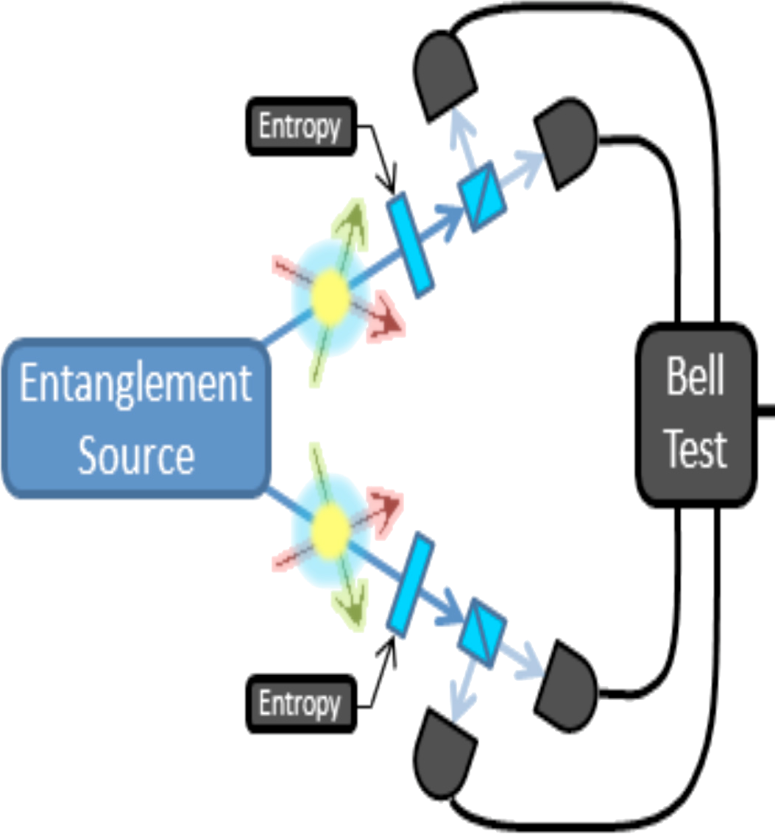
Collective Public Randomness
Any/all servers in tree contribute (ideally true) randomness via secrets vi and commitments Vi
Collective random output
is final response r1
Unpredictable
to all participants
Tamper-
resistant
Bias-
resistant
(with caveat)
v1
(c,r1)
v3
Notes:
Start the process
Commits for signature and items
Create the challenge for signature
Produce a signature on committed items
2 round trips

Slide 32
Talk Outline
Troubles with Authorities
Cothorities: Large-scale Collective Authorities
A Basic Tool: Scalable Collective ElGamal Log-Signing
The Availability Problem, and Two Solutions
Prototype and Preliminary Results
Future Work: Potential Applications

Slide 33
The Availability Problem
Assume server failures are rare but non-negligible
Availability loss, DoS vulnerability if not addressed
But persistently bad servers administratively booted
Two approaches:
Exceptions – currently implemented, working
Life Insurance – partially implemented, in-progress

Slide 34
Approach 1: Exceptions
If node A fails, the remaining nodes can provide a valid signature but
  For a modified collective key: K’= K * K⁻¹_{A}
  Using a modified commitment: V’= V * V⁻¹_{A}
  And response: r’= r – r_{A}
Client gets a signature under K’ along with an exception e_{A}
  e_{A} also lists conditions under which it was issued
Client accepts only if a quorum of nodes maintained

Slide 35
Public Randomness: The Caveat
Current version with exceptions for availability:
Protects from anyone predicting the future
Protects from anyone rigging the outcome
Not fully bias-protected if leader is malicious
Attack: assume leader colludes with k followers
Followers pretend to be offline in 2^{k} configs
Leader picks “best” of 2^{k} possible outcomes

Slide 36



Approach 2: Life insurance
Node "insures" its private key by depositing the key shares with other servers (insurers)
If node fails, others recover the key and continue
Use Shamir verifiable secret sharing (VSS)
s₁
s₂
s₃

Slide 37
Unbiasable Public Randomness
Life insurance approach can fix bias vulnerability
Collective commits to single unknown value
  Aggregate secret v1 combines every secret vi
  Fully unpredictable if any server is honest
Collective response can be only one value
  Response r1 depends only on k1, v1, c
  Fully unbiasable if protocol completes at all
Leader could still “self-DoS-attack”…
but such failures are rather noticeable

Slide 38
Talk Outline
Troubles with Authorities
Cothorities: Large-scale Collective Authorities
A Basic Tool: Scalable Collective ElGamal Log-Signing
The Availability Problem, and Two Solutions
Prototype and Preliminary Results
Future Work: Potential Applications

Slide 39
Implementation
Implemented in Go with dedis crypto library
  https://github.com/DeDiS/crypto
Schnorr multisignatures on Ed25519 curve
  AGL's Go port of DJB's optimized code
Run experiments on DeterLab
  Up to 4096 virtual CoSi nodes
  Multiplexed atop up 32 physical machines
  Latency: 100ms roundtrip between two servers

Slide 40
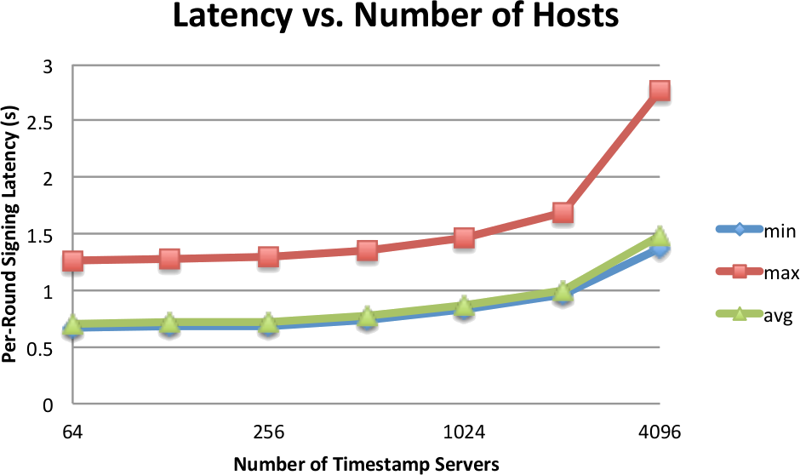
Preliminary Results
Notes:
Hosts vary from 64 to 4096, tree depth of 4
The higher the BF, the lower the depth, the smaller the network overhead

Slide 41
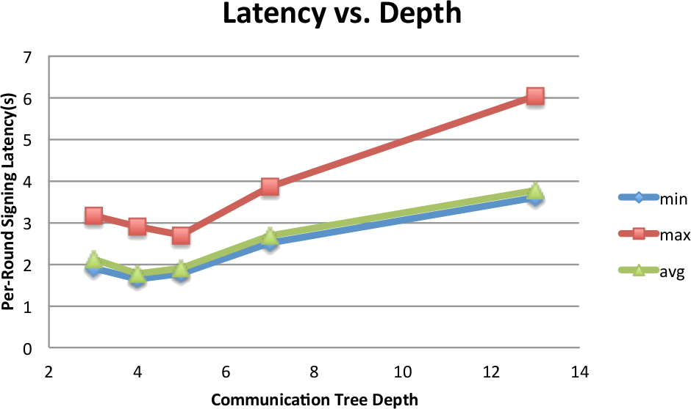
Preliminary Results
Notes:
Hosts vary from 64 to 4096, tree depth of 4
The higher the BF, the lower the depth, the smaller the network overhead

Slide 42
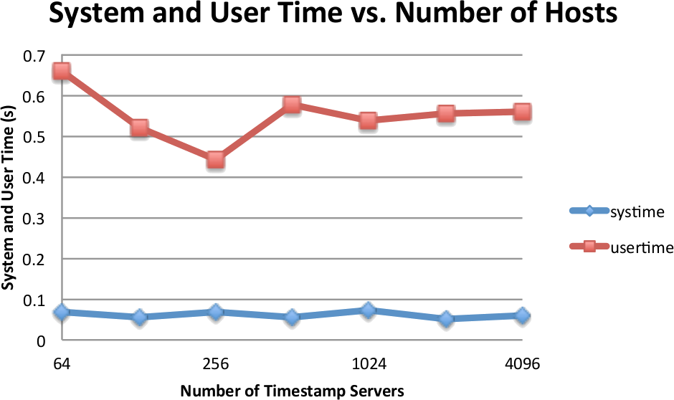
Preliminary Results
Notes:
Hosts vary from 64 to 4096, tree depth of 4
The higher the BF, the lower the depth, the smaller the network overhead

Slide 43
Talk Outline
Troubles with Authorities
Cothorities: Large-scale Collective Authorities
A Basic Tool: Scalable Collective ElGamal Log-Signing
The Availability Problem, and Two Solutions
Prototype and Preliminary Results
Future Work: Potential Applications

Slide 44
Logging and Timestamping
Already (or close to) usable for:
Tamper-evident logging
  History rewriting protection
  Equivocation protection
Secure timestamping
  Pre/post-dating protection
Large-scale Byzantine Consensus
  Propose/commit, view changes implemented
  Still need validation, evaluation, optimization

Slide 45
Secure Randomness/Lotteries
Current version with exceptions for availability:
Protects from anyone predicting the future
Protects from anyone rigging the outcome
Not yet fully bias-protected if leader malicious
Shamir secret-sharing version can fix bias risk
Collective commits to single unknown value
Ensures exactly that value as ultimate output

Slide 46


Certificate Cothorities
DigiNotar
Stolen CA Private Key
STOP!
CAs
Can't Forge
Certificate
Witnesses, Monitors
Attack
Fails
Real
Alice (Victim)
without
active checking
Notes:
the client takes time and delays page loads while doing those checks, and
The log/monitor checks might get blocked, e.g., by the evil state-controlled ISP

Slide 47
Certificate Cothorities
Proactive protection against fake certs, MITM
Ideal: browser vendor leads a cothority
  CAs join, check and collectively sign all certs
  Any CA can block signature if cert violates policy
    e.g., only Google CA can sign 'google.com' cert
Alternative: root CA leads a cothority
  Migrates sub-CAs into cothority membership,
  phases out availability of delegated authority
Alternative: based on Certificate Transparency
  Log servers as cothorities, collectively signed SCTs

Slide 48
A Better Blockchain?
Decentralized consensus, secure ledgers
Without proof-of-work, massive power waste
Without risk of temporary forks
Without 51% attack vulnerability
Stronger protection for clients, “light” nodes
  Just check one log-head signature for correctness
Efficient: with FawkesCoin hash-based ledger,
just one public-key crypto operation per round
Scalable: every server need not store, verify
every record throughout blockchain history

Slide 49
Conclusion
Cothorities build on old ideas
Distributed/Byzantine consensus protocols
Threshold cryptography, multisignatures
Show that they can scale to thousands of servers
Strongest-link security among many witnesses
Practical: demonstrated for 4000+ servers
Efficient: 1.5-second signing latency at scale
More details: http://arxiv.org/abs/1503.08768
Notes:
demonstrating that large-scale cothorities are a viable alternative to current centralized-trust authorities.

